Slide 1

Chapter 4
Network Layer:
The Data Plane
Acknowledgments:
The contents in this file are based on the slides accompanying the book Computer Networking: A Top Down Approach, 7th edition.
Computer Networking: A Top Down Approach
7th Edition, Global Edition
Jim Kurose, Keith Ross
Pearson
April 2016

Slide 2
Chapter 4: outline
4.1 Overview of Network layer
  data plane
  control plane
4.3 IP: Internet Protocol
  datagram format
  fragmentation
  IPv4 addressing
  DHCP and network address translation
  ICMP
  IPv6
4.4 Generalized Forward and SDN
  match
  action
  OpenFlow examples of match-plus-action in action

Slide 3
Why Internetworking?
To build a “network of networks” or internet
  operating over multiple, coexisting, different network technologies
  providing ubiquitous connectivity through IP packet transfer
  achieving huge economies of scale
H
H
Net 3
Net 1
Net 5
Net 5
G
G
G
G
Net 5
Net 5
H
G
G
Net 2
Net 4
Net 5
Net 5
H

Slide 4
Why Internetworking?
To provide universal communication services
  independent of underlying network technologies
  providing common interface to user applications
H
Reliable Stream Service
H
Net 3
Net 1
Net 5
Net 5
G
G
G
G
Net 5
Net 5
H
G
G
Net 2
Net 4
Net 5
Net 5
H

Slide 5
Why Internetworking?
To provide distributed applications
  Any application designed to operate based on Internet communication services immediately operates across the entire Internet
  Rapid deployment of new applications
    Email, WWW, Peer-to-peer
  Applications independent of network technology
    New networks can be introduced below
    Old network technologies can be retired

Slide 6
TCP/IP Protocol Suite
HTTP
SMTP
DNS
RTP
Distributed applications
Reliable stream service
TCP
UDP
Best-effort
connectionless packet transfer
IP
(ICMP, ARP)
Network
Interface 1
Network
Interface 2
Network
Interface 3
Diverse network technologies

Slide 7
Internet Protocol Approach
IP packets transfer information across Internet
Host A IP → router→ router…→ router→ Host B IP
IP layer in each router determines next hop (router)
Network interfaces transfer IP packets across networks
Host A
Router
Host B
Router
Transport
Layer
Internet
Layer
Transport
Layer
Internet
Layer
Internet
Layer
Network
Interface
Net 1
Internet
Layer
Net 5
Network
Interface
Network
Interface
Network
Interface
Router
Net 4
Internet
Layer
Net 5
Net 3
Net 2
Net 5
Net 5
Network
Interface

Slide 8
Encapsulation
TCP Header contains source & destination port numbers
HTTP Request
IP Header contains source and destination IP addresses; transport protocol type
TCP header
HTTP Request
Ethernet Header contains source & destination MAC addresses; network protocol type
IP header
TCP header
HTTP Request
Ethernet header
IP header
TCP header
FCS
HTTP Request

Slide 9

















Network layer
transport segment from sending to receiving host
on sending side encapsulates segments into datagrams
on receiving side, delivers segments to transport layer
network layer protocols in every host, router
router examines header fields in all IP datagrams passing through it
application
transport
network
data link
physical
network
data link
physical
network
data link
physical
network
data link
physical
network
data link
physical
network
data link
physical
network
data link
physical
network
data link
physical
network
data link
physical
network
data link
physical
application
transport
network
data link
physical
network
data link
physical
network
data link
physical

Slide 10
Two key network-layer functions
network-layer functions:
forwarding: move packets from router’s input to appropriate router output
routing: determine route taken by packets from source to destination
  routing algorithms
analogy: taking a trip
forwarding: process of getting through single interchange
routing: process of planning trip from source to destination

Slide 11
Network layer: data plane, control plane
Data plane
local, per-router function
determines how datagram arriving on router input port is forwarded to router output port
forwarding function
Control plane
network-wide logic
determines how datagram is routed among routers along end-end path from source host to destination host
two control-plane approaches:
  traditional routing algorithms: implemented in routers
  software-defined networking (SDN): implemented in (remote) servers
values in arriving
packet header
0111
1
3
2

Slide 12

Per-router control plane
traditional approach!
Individual routing algorithm components in each and every router interact in the control plane
Routing
Algorithm
control
plane
data
plane
values in arriving
packet header
0111
1
3
2

Slide 13
Logically centralized control plane
new approach!
A distinct (typically remote) controller interacts with local control agents (CAs)
Remote Controller
control
plane
data
plane
CA
CA
CA
CA
CA
values in arriving
packet header
0111
1
3
2

Slide 14
Network service model
Q: What service model for “channel” transporting datagrams from sender to receiver?
example services for individual datagrams:
guaranteed delivery
guaranteed delivery with less than 40 msec delay
example services for a flow of datagrams:
in-order datagram delivery
guaranteed minimum bandwidth to flow
restrictions on changes in inter-packet spacing

Slide 15
Network layer service models:
Network
Architecture
Internet
ATM
ATM
ATM
ATM
Service
Model
best effort
CBR
VBR
ABR
UBR
Guarantees ?
Congestion
feedback
no (inferred
via loss)
no
congestion
no
congestion
yes
no
Bandwidth
none
constant
rate
guaranteed
rate
guaranteed
minimum
none
Loss
no
yes
yes
no
no
Order
no
yes
yes
yes
yes
Timing
no
yes
yes
no
no
ATM (Asynchronous Transfer Mode) networks are broadband integrated services networks, developed from the telecommunications industry

Slide 16
Chapter 4: outline
4.1 Overview of Network layer
  data plane
  control plane
4.3 IP: Internet Protocol
  datagram format
  fragmentation
  IPv4 addressing
  DHCP and network address translation
  ICMP
  IPv6
4.4 Generalized Forward and SDN
  match
  action
  OpenFlow examples of match-plus-action in action

Slide 17
The Internet network layer
host, router network layer functions:
transport layer: TCP, UDP
routing protocols
path selection
RIP, OSPF, BGP
IP protocol
addressing conventions
datagram format
packet handling conventions
network
layer
forwarding
table
ICMP protocol
error reporting
router “signaling”
link layer
physical layer

Slide 18
IP datagram format
IP protocol version
number
32 bits
total datagram
length (bytes)
header length
(bytes)
head.
len
type of
service
ver
length
for
fragmentation/
reassembly
“type” of data
flgs
fragment
offset
16-bit identifier
max number
remaining hops
(decremented at
each router)
time to
live
upper
layer
header
checksum
32 bit source IP address
upper layer protocol
to deliver payload to
32 bit destination IP address
options (if any)
e.g. timestamp,
record route
taken, specify
list of routers
to visit.
data
(variable length,
typically a TCP
or UDP segment)
how much overhead?
20 bytes of TCP
20 bytes of IP
= 40 bytes + app layer overhead

Slide 19

IP fragmentation, reassembly
network links have MTU (max.transfer size) - largest possible link-level frame
  different link types, different MTUs
large IP datagram divided (“fragmented”) within net
  one datagram becomes several datagrams
  “reassembled” only at final destination
  IP header bits used to identify, order related fragments
…
fragmentation:
in: one large datagram
out: 3 smaller datagrams
reassembly
…

Slide 20
IP fragmentation, reassembly
length
=4000
ID
=x
fragflag
=0
offset
=0
example:
4000 byte datagram
MTU = 1500 bytes
one large datagram becomes
several smaller datagrams
1480 bytes in
data field
length
=1500
ID
=x
fragflag
=1
offset
=0
offset =
1480/8
length
=1500
ID
=x
fragflag
=1
offset
=185
length
=1040
ID
=x
fragflag
=0
offset
=370

Slide 21
Chapter 4: outline
4.1 Overview of Network layer
  data plane
  control plane
4.2 What’s inside a router
4.3 IP: Internet Protocol
  datagram format
  fragmentation
  IPv4 addressing
  DHCP and network address translation
  ICMP
  IPv6
4.4 Generalized Forward and SDN
  match
  action
  OpenFlow examples of match-plus-action in action

Slide 22
Internet Names & Addresses
Internet Names
Each host has a unique name
  Independent of physical location
  Facilitate memorization by humans
  Domain Name
  Organization under single administrative unit
Host Name
  Name given to host computer
User Name
  Name assigned to user
leongarcia@comm.utoronto.ca
Internet Addresses
Each host has globally unique logical 32 bit IP address
Separate address for each physical connection to a network
Routing decision is done based on destination IP address
IP address has two parts:
  netid and hostid
  netid unique
  netid facilitates routing
Dotted Decimal Notation:
  int1.int2.int3.int4
  (intj = jth octet)
  IP address of 10000000 10000111 01000100 00000101
  is 128.135.68.5 in dotted-decimal notation
DNS resolves IP name to IP address

Slide 23
Module 11: IPv4 Addressing
Note: the slides on IPv4 Addressing are from CCNA Introduction to Networks v7.0 (ITN), Module 11
Notes:
Cisco Networking Academy Program
Introduction to Networks v7.0 (ITN)
Module 11: IPv4 Addressing

Slide 24
11.1 IPv4 Address Structure
Notes:
11 – IPv4 Addressing
11.1 – IPv4 Address Structure

Slide 25
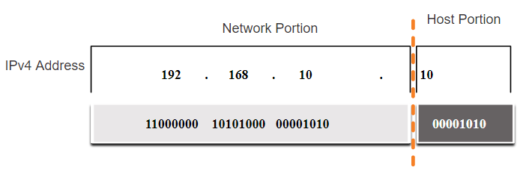
IPv4 Address Structure
Network and Host Portions
An IPv4 address is a 32-bit hierarchical address that is made up of a network portion and a host portion.
When determining the network portion versus the host portion, you must look at the 32-bit stream.
A subnet mask is used to determine the network and host portions.
Notes:
11 – IPv4 Addressing
11.1 – IPv4 Address Structure
11.1.1 – Network and Host Portions

Slide 26
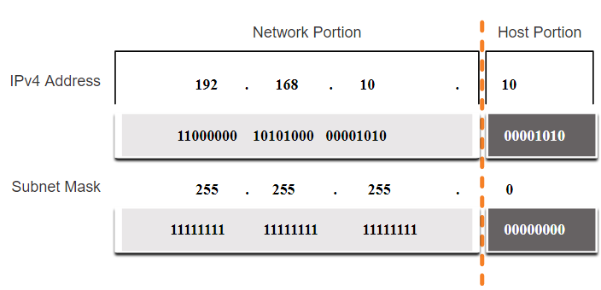
IPv4 Address Structure
The Subnet Mask
To identify the network and host portions of an IPv4 address, the subnet mask is compared to the IPv4 address bit for bit, from left to right.
The actual process used to identify the network and host portions is called ANDing.
Notes:
11 – IPv4 Addressing
11.1 – IPv4 Address Structure
11.1.2 – The Subnet Mask

Slide 27
IPv4 Address Structure
The Prefix Length
A prefix length is a less cumbersome method used to identify a subnet mask address.
The prefix length is the number of bits set to 1 in the subnet mask.
It is written in “slash notation” therefore, count the number of bits in the subnet mask and prepend it with a slash.
Subnet Mask | 32-bit Address | Prefix Length
255.0.0.0 | 11111111.00000000.00000000.00000000 | /8
255.255.0.0 | 11111111.11111111.00000000.00000000 | /16
255.255.255.0 | 11111111.11111111.11111111.00000000 | /24
255.255.255.128 | 11111111.11111111.11111111.10000000 | /25
255.255.255.192 | 11111111.11111111.11111111.11000000 | /26
255.255.255.224 | 11111111.11111111.11111111.11100000 | /27
255.255.255.240 | 11111111.11111111.11111111.11110000 | /28
255.255.255.248 | 11111111.11111111.11111111.11111000 | /29
255.255.255.252 | 11111111.11111111.11111111.11111100 | /30
Notes:
11 – IPv4 Addressing
11.1 – IPv4 Address Structure
11.1.3 – The Prefix Length

Slide 28
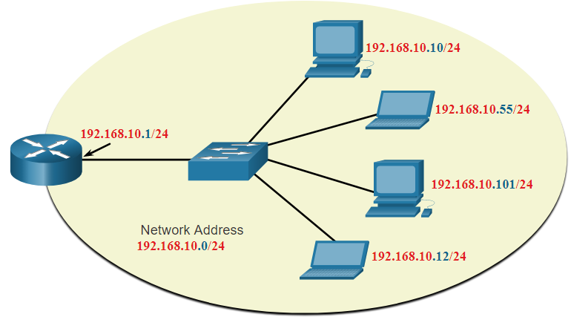
IPv4 Address Structure
Network, Host, and Broadcast Addresses
Within each network are three types of IP addresses:
  Network address
  Host addresses
  Broadcast address
 | Network Portion | Host Portion | Host Bits
Subnet mask 255.255.255.0 or /24 | 255 255 255 11111111 11111111 11111111 | 0 00000000
Network address 192.168.10.0 or /24 | 192 168 10 11000000 10100000 00001010 | 0 00000000 | All 0s
First address 192.168.10.1 or /24 | 192 168 10 11000000 10100000 00001010 | 1 00000001 | All 0s and a 1
Last address 192.168.10.254 or /24 | 192 168 10 11000000 10100000 00001010 | 254 11111110 | All 1s and a 0
Broadcast address 192.168.10.255 or /24 | 192 168 10 11000000 10100000 00001010 | 255 11111111 | All 1s
Notes:
11 – IPv4 Addressing
11.1 – IPv4 Address Structure
11.1.6 – Network, Host, and Broadcast Addresses
11.1.7 – Activity – ANDing to Determine the Network Address
11.1.8 – Check Your Understanding - IPv4 Address Structure

Slide 29
11.2 IPv4 Unicast, Broadcast, and Multicast
Notes:
11 – IPv4 Addressing
11.2 – IPv4 Unicast, Broadcast, and Multicast

Slide 30
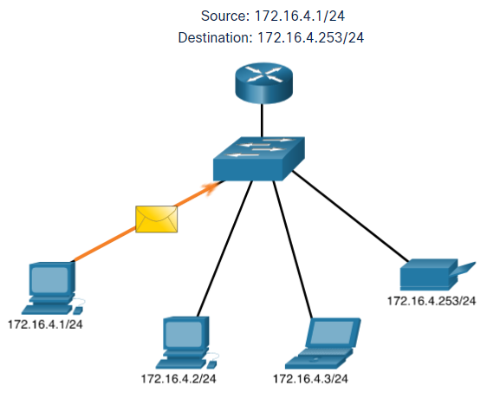
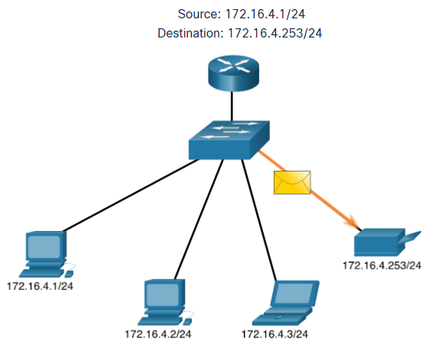
IPv4 Unicast, Broadcast, and Multicast
Unicast
Unicast transmission is sending a packet to one destination IP address.
For example, the PC at 172.16.4.1 sends a unicast packet to the printer at 172.16.4.253.
Notes:
11 – IPv4 Addressing
11.2 – IPv4 Unicast, Broadcast, and Multicast
11.2.1 – Unicast

Slide 31
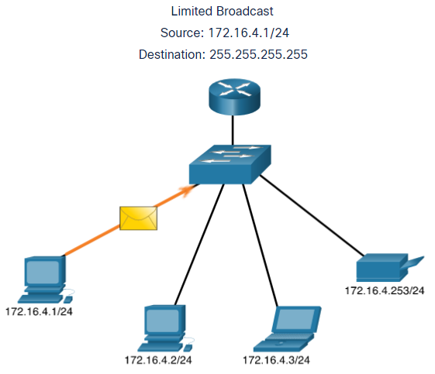
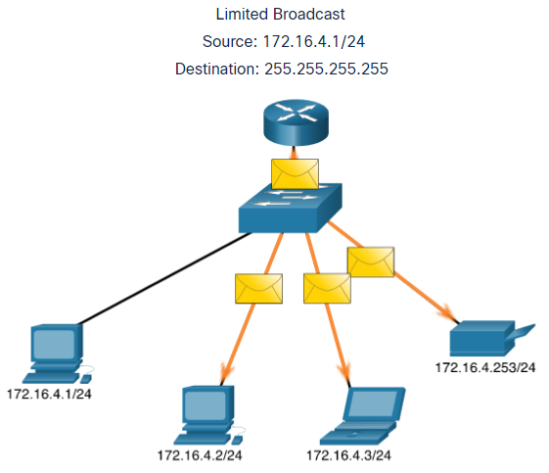
IPv4 Unicast, Broadcast, and Multicast
Broadcast
Broadcast transmission is sending a packet to all other destination IP addresses.
For example, the PC at 172.16.4.1 sends a broadcast packet to all IPv4 hosts.
Notes:
11 – IPv4 Addressing
11.2 – IPv4 Unicast, Broadcast, and Multicast
11.2.2 – Broadcast

Slide 32
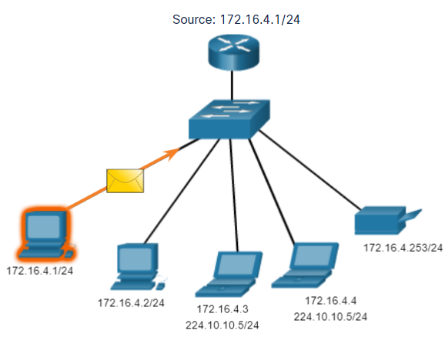
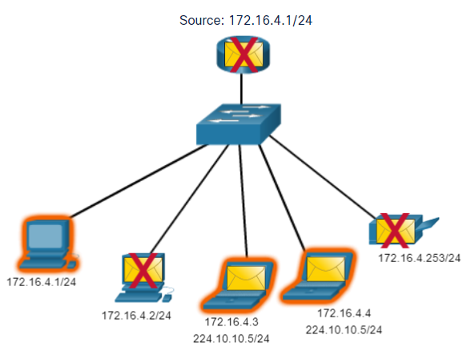
IPv4 Unicast, Broadcast, and Multicast
Multicast
Multicast transmission is sending a packet to a multicast address group.
For example, the PC at 172.16.4.1 sends a multicast packet to the multicast group address 224.10.10.5.
Notes:
11 – IPv4 Addressing
11.2 – IPv4 Unicast, Broadcast, and Multicast
11.2.3 – Multicast
11.2.4 – Activity - Unicast, Broadcast, or Multicast

Slide 33
11.3 Types of IPv4 Addresses
Notes:
11 – IPv4 Addressing
11.3 – Types of IPv4 Addresses

Slide 34
Types of IPv4 Addresses
Public and Private IPv4 Addresses
As defined in in RFC 1918, public IPv4 addresses are globally routed between internet service provider (ISP) routers.
However, private addresses are not globally routable.
Private addresses are common blocks of addresses used by most organizations to assign IPv4 addresses to internal hosts.
Private IPv4 addresses are not unique and can be used internally within any network.
Network Address and Prefix | RFC 1918 Private Address Range
10.0.0.0/8 | 10.0.0.0 - 10.255.255.255
172.16.0.0/12 | 172.16.0.0 - 172.31.255.255
192.168.0.0/16 | 192.168.0.0 - 192.168.255.255
Notes:
11 – IPv4 Addressing
11.3 – Types of IPv4 Addresses
11.3.1 – Public and Private IPv4 Addresses

Slide 35
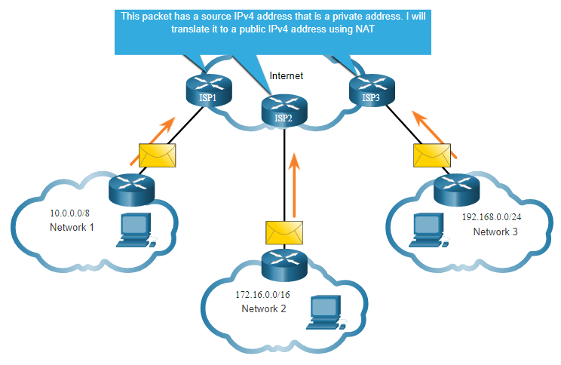
Types of IPv4 Addresses
Routing to the Internet
Network Address Translation (NAT) translates private IPv4 addresses to public IPv4 addresses.
NAT is typically enabled on the edge router connecting to the internet.
It translates the internal private address to a public global IP address.
Notes:
11 – IPv4 Addressing
11.3 – Types of IPv4 Addresses
11.3.2 – Routing to the Internet
11.3.3 – Activity - Pass or Block IPv4 Addresses

Slide 36

Types of IPv4 Addresses
Special Use IPv4 Addresses
Loopback addresses
127.0.0.0 /8 (127.0.0.1 to 127.255.255.254)
Commonly identified as only 127.0.0.1
Used on a host to test if TCP/IP is operational.
Link-Local addresses
169.254.0.0 /16 (169.254.0.1 to 169.254.255.254)
Commonly known as the Automatic Private IP Addressing (APIPA) addresses or self-assigned addresses.
Used by Windows DHCP clients to self-configure when no DHCP servers are available.
Notes:
11 – IPv4 Addressing
11.3 – Types of IPv4 Addresses
11.3.4 – Special Use IPv4 Addresses

Slide 37
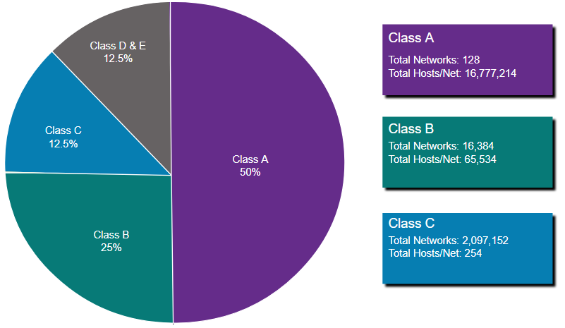
Types of IPv4 Addresses
Legacy Classful Addressing
RFC 790 (1981) allocated IPv4 addresses in classes
Class A (0.0.0.0/8 to 127.0.0.0/8)
Class B (128.0.0.0 /16 – 191.255.0.0 /16)
Class C (192.0.0.0 /24 – 223.255.255.0 /24)
Class D (224.0.0.0 to 239.0.0.0)
Class E (240.0.0.0 – 255.0.0.0)
Classful addressing wasted many IPv4 addresses.
Classful address allocation was replaced with classless addressing which ignores the rules of classes (A, B, C).
Notes:
11 – IPv4 Addressing
11.3 – Types of IPv4 Addresses
11.3.5 – Legacy Classful Addressing

Slide 38
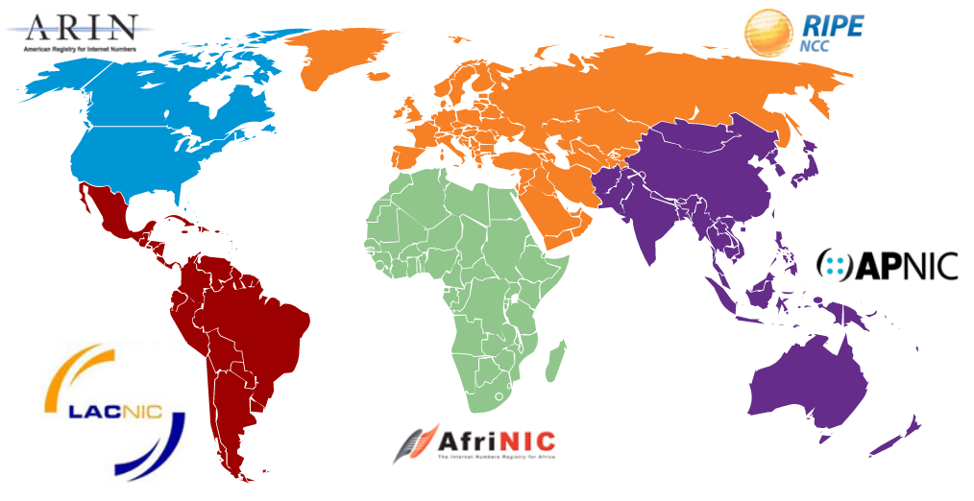
Types of IPv4 Addresses
Assignment of IP Addresses
The Internet Assigned Numbers Authority (IANA) manages and allocates blocks of IPv4 and IPv6 addresses to five Regional Internet Registries (RIRs).
RIRs are responsible for allocating IP addresses to ISPs who provide IPv4 address blocks to smaller ISPs and organizations.
Notes:
11 – IPv4 Addressing
11.3 – Types of IPv4 Addresses
11.3.6 – Assignment of IP Addresses
11.3.7 – Activity - Public or Private IPv4 Address
11.3.8 – Check Your Understanding - Types of IPv4 Addresses

Slide 39
11.4 Network Segmentation
Notes:
11 – IPv4 Addressing
11.4 – Network Segmentation

Slide 40
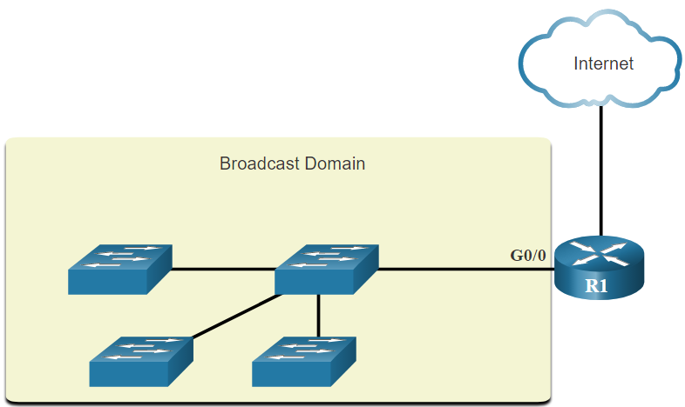
Network Segmentation
Broadcast Domains and Segmentation
Many protocols use broadcasts or multicasts (e.g., ARP use broadcasts to locate other devices, hosts send DHCP discover broadcasts to locate a DHCP server.)
Switches propagate broadcasts out all interfaces except the interface on which it was received.
The only device that stops broadcasts is a router.
Routers do not propagate broadcasts.
Each router interface connects to a broadcast domain and broadcasts are only propagated within that specific broadcast domain.
Notes:
11 – IPv4 Addressing
11.4 – Network Segmentation
11.4.1 – Broadcast Domains and Segmentation

Slide 41
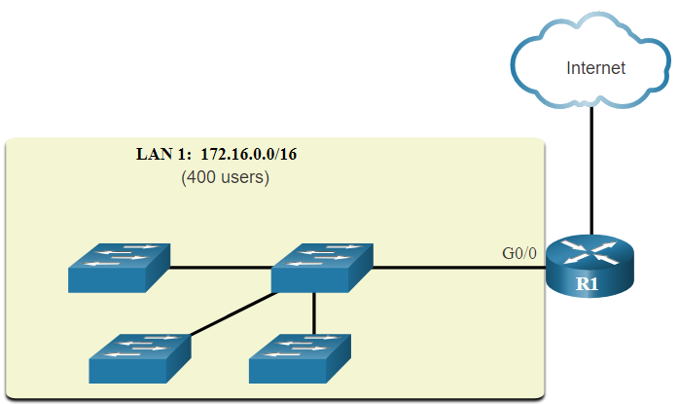
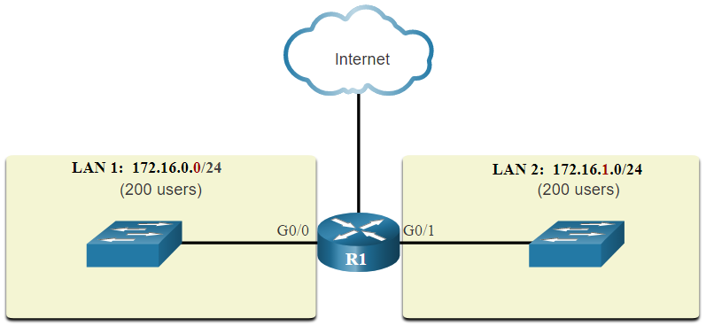
Network Segmentation
Problems with Large Broadcast Domains
A problem with a large broadcast domain is that these hosts can generate excessive broadcasts and negatively affect the network.
The solution is to reduce the size of the network to create smaller broadcast domains in a process called subnetting.
Dividing the network address 172.16.0.0 /16 into two subnets of 200 users each: 172.16.0.0 /24 and 172.16.1.0 /24.
Broadcasts are only propagated within the smaller broadcast domains.
Notes:
11 – IPv4 Addressing
11.4 – Network Segmentation
11.4.2 – Problems with Large Broadcast Domains

Slide 42
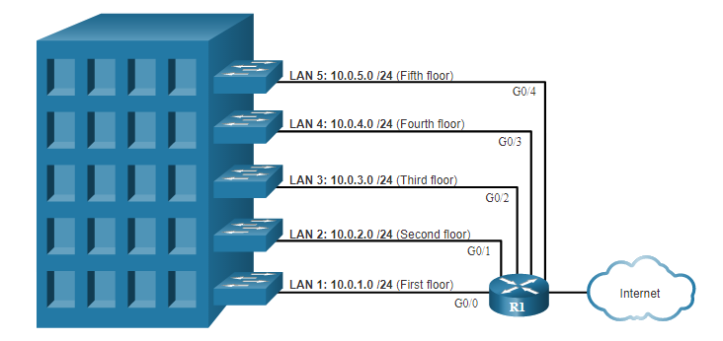
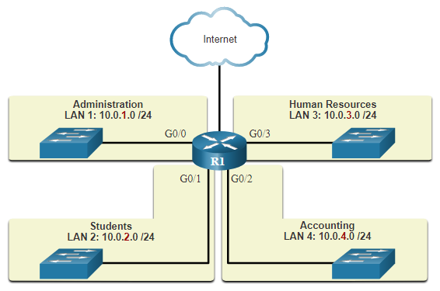
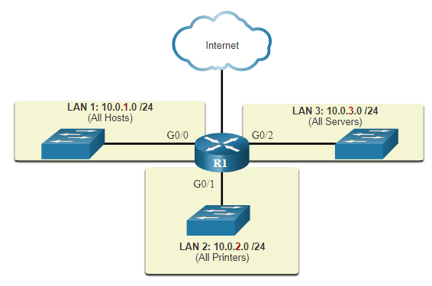
Network Segmentation
Reasons for Segmenting Networks
Subnetting reduces overall network traffic and improves network performance.
It can be used to implement security policies between subnets.
Subnetting reduces the number of devices affected by abnormal broadcast traffic.
Subnets are used for a variety of reasons including by:
Location
Group or Function
Device Type
Notes:
11 – IPv4 Addressing
11.4 – Network Segmentation
11.4.3 – Reasons for Segmenting Networks
11.4.4 – Check Your Understanding - Network Segmentation

Slide 43
11.5 Subnet an IPv4 Network
Notes:
11 – IPv4 Addressing
11.5 – Subnet an IPv4 Network

Slide 44
Subnet an IPv4 Network
Subnet on an Octet Boundary
Networks are most easily subnetted at the octet boundary of /8, /16, and /24.
Notice that using longer prefix lengths decreases the number of hosts per subnet.
Prefix Length | Subnet Mask | Subnet Mask in Binary (n = network, h = host) | # of hosts
/8 | 255.0.0.0 | nnnnnnnn.hhhhhhhh.hhhhhhhh.hhhhhhhh 11111111.00000000.00000000.00000000 | 16,777,214
/16 | 255.255.0.0 | nnnnnnnn.nnnnnnnn.hhhhhhhh.hhhhhhhh 11111111.11111111.00000000.00000000 | 65,534
/24 | 255.255.255.0 | nnnnnnnn.nnnnnnnn.nnnnnnnn.hhhhhhhh 11111111.11111111.11111111.00000000 | 254
Notes:
11 – IPv4 Addressing
11.5 – Subnet an IPv4 Network
11.5.1 – Subnet on an Octet Boundary

Slide 45
Subnet an IPv4 Network
Subnet on an Octet Boundary (Cont.)
In the first table 10.0.0.0/8 is subnetted using /16 and in the second table, a /24 mask.
Subnet Address (256 Possible Subnets) | Host Range (65,534 possible hosts per subnet) | Broadcast
10.0.0.0/16 | 10.0.0.1 - 10.0.255.254 | 10.0.255.255
10.1.0.0/16 | 10.1.0.1 - 10.1.255.254 | 10.1.255.255
10.2.0.0/16 | 10.2.0.1 - 10.2.255.254 | 10.2.255.255
10.3.0.0/16 | 10.3.0.1 - 10.3.255.254 | 10.3.255.255
10.4.0.0/16 | 10.4.0.1 - 10.4.255.254 | 10.4.255.255
10.5.0.0/16 | 10.5.0.1 - 10.5.255.254 | 10.5.255.255
10.6.0.0/16 | 10.6.0.1 - 10.6.255.254 | 10.6.255.255
10.7.0.0/16 | 10.7.0.1 - 10.7.255.254 | 10.7.255.255
... | ... | ...
10.255.0.0/16 | 10.255.0.1 - 10.255.255.254 | 10.255.255.255
Subnet Address (65,536 Possible Subnets) | Host Range (254 possible hosts per subnet) | Broadcast
10.0.0.0/24 | 10.0.0.1 - 10.0.0.254 | 10.0.0.255
10.0.1.0/24 | 10.0.1.1 - 10.0.1.254 | 10.0.1.255
10.0.2.0/24 | 10.0.2.1 - 10.0.2.254 | 10.0.2.255
… | … | …
10.0.255.0/24 | 10.0.255.1 - 10.0.255.254 | 10.0.255.255
10.1.0.0/24 | 10.1.0.1 - 10.1.0.254 | 10.1.0.255
10.1.1.0/24 | 10.1.1.1 - 10.1.1.254 | 10.1.1.255
10.1.2.0/24 | 10.1.2.1 - 10.1.2.254 | 10.1.2.255
… | … | …
10.100.0.0/24 | 10.100.0.1 - 10.100.0.254 | 10.100.0.255
... | ... | ...
10.255.255.0/24 | 10.255.255.1 - 10.2255.255.254 | 10.255.255.255
Notes:
11 – IPv4 Addressing
11.5 – Subnet an IPv4 Network
11.5.1 – Subnet on an Octet Boundary (Cont.)

Slide 46
Subnet an IPv4 Network
Subnet within an Octet Boundary
Refer to the table to see six ways to subnet a /24 network.
Prefix Length | Subnet Mask | Subnet Mask in Binary (n = network, h = host) | # of subnets | # of hosts
/25 | 255.255.255.128 | nnnnnnnn.nnnnnnnn.nnnnnnnn.nhhhhhhh 11111111.11111111.11111111.10000000 | 2 | 126
/26 | 255.255.255.192 | nnnnnnnn.nnnnnnnn.nnnnnnnn.nnhhhhhh 11111111.11111111.11111111.11000000 | 4 | 62
/27 | 255.255.255.224 | nnnnnnnn.nnnnnnnn.nnnnnnnn.nnnhhhhh 11111111.11111111.11111111.11100000 | 8 | 30
/28 | 255.255.255.240 | nnnnnnnn.nnnnnnnn.nnnnnnnn.nnnnhhhh 11111111.11111111.11111111.11110000 | 16 | 14
/29 | 255.255.255.248 | nnnnnnnn.nnnnnnnn.nnnnnnnn.nnnnnhhh 11111111.11111111.11111111.11111000 | 32 | 6
/30 | 255.255.255.252 | nnnnnnnn.nnnnnnnn.nnnnnnnn.nnnnnnhh 11111111.11111111.11111111.11111100 | 64 | 2
Notes:
11 – IPv4 Addressing
11.5 – Subnet an IPv4 Network
11.5.2 – Subnet within an Octet Boundary

Slide 47
11.6 Subnet a Slash 16 and a Slash 8 Prefix
Notes:
11 – IPv4 Addressing
11.6 – Subnet a Slash 16 and a Slash 8 Prefix

Slide 48
Subnet a Slash 16 and a Slash 8 Prefix
Create Subnets with a Slash 16 prefix
Prefix Length | Subnet Mask | Network Address (n = network, h = host) | # of subnets | # of hosts
/17 | 255.255.128.0 | nnnnnnnn.nnnnnnnn.nhhhhhhh.hhhhhhhh 11111111.11111111.10000000.00000000 | 2 | 32766
/18 | 255.255.192.0 | nnnnnnnn.nnnnnnnn.nnhhhhhh.hhhhhhhh 11111111.11111111.11000000.00000000 | 4 | 16382
/19 | 255.255.224.0 | nnnnnnnn.nnnnnnnn.nnnhhhhh.hhhhhhhh 11111111.11111111.11100000.00000000 | 8 | 8190
/20 | 255.255.240.0 | nnnnnnnn.nnnnnnnn.nnnnhhhh.hhhhhhhh 11111111.11111111.11110000.00000000 | 16 | 4094
/21 | 255.255.248.0 | nnnnnnnn.nnnnnnnn.nnnnnhhh.hhhhhhhh 11111111.11111111.11111000.00000000 | 32 | 2046
/22 | 255.255.252.0 | nnnnnnnn.nnnnnnnn.nnnnnnhh.hhhhhhhh 11111111.11111111.11111100.00000000 | 64 | 1022
/23 | 255.255.254.0 | nnnnnnnn.nnnnnnnn.nnnnnnnh.hhhhhhhh 11111111.11111111.11111110.00000000 | 128 | 510
/24 | 255.255.255.0 | nnnnnnnn.nnnnnnnn.nnnnnnnn.hhhhhhhh 11111111.11111111.11111111.00000000 | 256 | 254
/25 | 255.255.255.128 | nnnnnnnn.nnnnnnnn.nnnnnnnn.nhhhhhhh 11111111.11111111.11111111.10000000 | 512 | 126
/26 | 255.255.255.192 | nnnnnnnn.nnnnnnnn.nnnnnnnn.nnhhhhhh 11111111.11111111.11111111.11000000 | 1024 | 62
/27 | 255.255.255.224 | nnnnnnnn.nnnnnnnn.nnnnnnnn.nnnhhhhh 11111111.11111111.11111111.11100000 | 2048 | 30
/28 | 255.255.255.240 | nnnnnnnn.nnnnnnnn.nnnnnnnn.nnnnhhhh 11111111.11111111.11111111.11110000 | 4096 | 14
/29 | 255.255.255.248 | nnnnnnnn.nnnnnnnn.nnnnnnnn.nnnnnhhh 11111111.11111111.11111111.11111000 | 8192 | 6
/30 | 255.255.255.252 | nnnnnnnn.nnnnnnnn.nnnnnnnn.nnnnnnhh 11111111.11111111.11111111.11111100 | 16384 | 2
The table highlights all the possible scenarios for subnetting a /16 prefix.
Notes:
11 – IPv4 Addressing
11.6 – Subnet a Slash 16 and a Slash 8 Prefix
11.6.1 – Create Subnets with a Slash 16 prefix

Slide 49
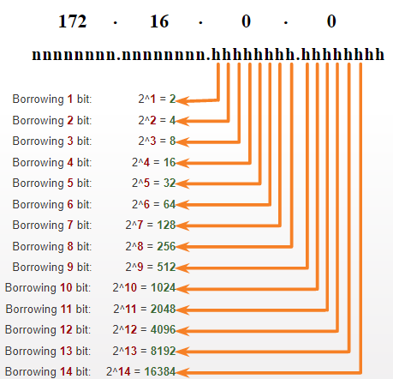
Subnet a Slash 16 and a Slash 8 Prefix
Create 100 Subnets with a Slash 16 prefix
Consider a large enterprise that requires at least 100 subnets and has chosen the private address 172.16.0.0/16 as its internal network address.
The figure displays the number of subnets that can be created when borrowing bits from the third octet and the fourth octet.
Notice there are now up to 14 host bits that can be borrowed (i.e., last two bits cannot be borrowed).
To satisfy the requirement of 100 subnets for the enterprise, 7 bits (i.e., 2⁷ = 128 subnets) would need to be borrowed (for a total of 128 subnets).
Notes:
11 – IPv4 Addressing
11.6 – Subnet a Slash 16 and a Slash 8 Prefix
11.6.2 – Create 100 Subnets with a Slash 16 prefix

Slide 50
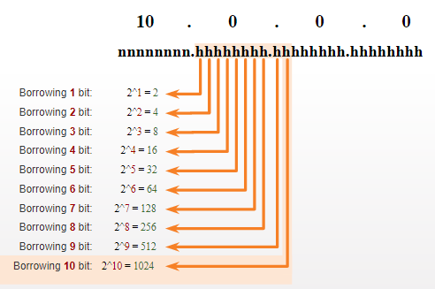
Subnet a Slash 16 and a Slash 8 Prefix
Create 1000 Subnets with a Slash 8 prefix
Consider a small ISP that requires 1000 subnets for its clients using network address 10.0.0.0/8 which means there are 8 bits in the network portion and 24 host bits available to borrow toward subnetting.
The figure displays the number of subnets that can be created when borrowing bits from the second and third.
Notice there are now up to 22 host bits that can be borrowed (i.e., last two bits cannot be borrowed).
To satisfy the requirement of 1000 subnets for the enterprise, 10 bits (i.e., 2¹⁰=1024 subnets) would need to be borrowed (for a total of 128 subnets)
Notes:
11 – IPv4 Addressing
11.6 – Subnet a Slash 16 and a Slash 8 Prefix
11.6.3 – Create 1000 Subnets with a Slash 8 prefix

Slide 51
11.7 Subnet to Meet Requirements
Notes:
11 – IPv4 Addressing
11.7 – Subnet to Meet Requirements

Slide 52
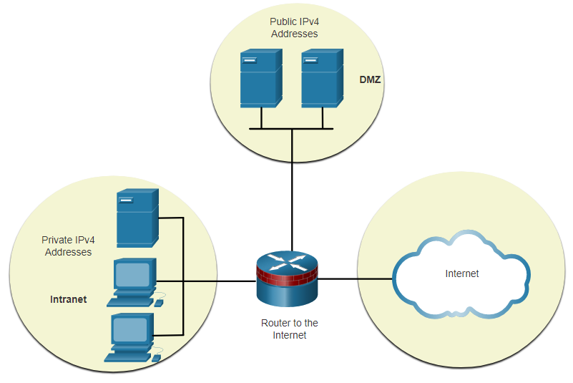
Subnet to Meet Requirements
Subnet Private versus Public IPv4 Address Space
Enterprise networks will have an:
Intranet - A company’s internal network typically using private IPv4 addresses.
DMZ – A company’s internet facing servers. Devices in the DMZ use public IPv4 addresses.
A company could use the 10.0.0.0/8 and subnet on the /16 or /24 network boundary.
The DMZ devices would have to be configured with public IP addresses.
DMZ - demilitarized zone
Notes:
11 – IPv4 Addressing
11.7 – Subnet to Meet Requirements
11.7.1 – Subnet Private versus Public IPv4 Address Space

Slide 53
Subnet to Meet Requirements
Minimize Unused Host IPv4 Addresses and Maximize Subnets
There are two considerations when planning subnets:
The number of host addresses required for each network
The number of individual subnets needed
Prefix Length | Subnet Mask | Subnet Mask in Binary (n = network, h = host) | # of subnets | # of hosts
/25 | 255.255.255.128 | nnnnnnnn.nnnnnnnn.nnnnnnnn.nhhhhhhh 11111111.11111111.11111111.10000000 | 2 | 126
/26 | 255.255.255.192 | nnnnnnnn.nnnnnnnn.nnnnnnnn.nnhhhhhh 11111111.11111111.11111111.11000000 | 4 | 62
/27 | 255.255.255.224 | nnnnnnnn.nnnnnnnn.nnnnnnnn.nnnhhhhh 11111111.11111111.11111111.11100000 | 8 | 30
/28 | 255.255.255.240 | nnnnnnnn.nnnnnnnn.nnnnnnnn.nnnnhhhh 11111111.11111111.11111111.11110000 | 16 | 14
/29 | 255.255.255.248 | nnnnnnnn.nnnnnnnn.nnnnnnnn.nnnnnhhh 11111111.11111111.11111111.11111000 | 32 | 6
/30 | 255.255.255.252 | nnnnnnnn.nnnnnnnn.nnnnnnnn.nnnnnnhh 11111111.11111111.11111111.11111100 | 64 | 2
Notes:
11 – IPv4 Addressing
11.7 – Subnet to Meet Requirements
11.7.2 – Minimize Unused Host IPv4 Addresses and Maximize Subnets

Slide 54
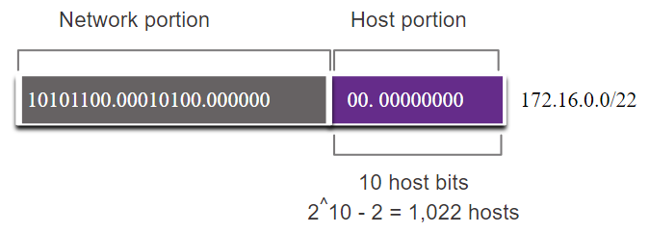
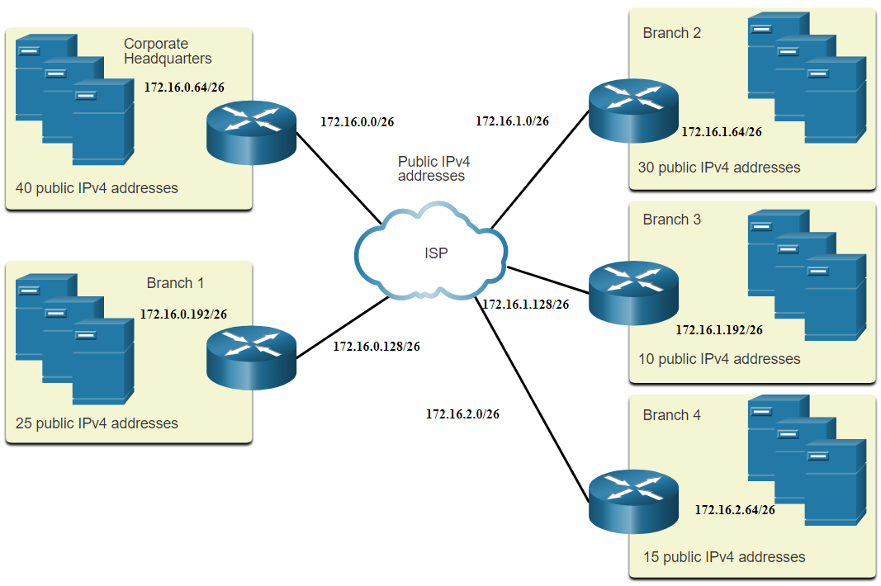
Subnet to Meet Requirements
Example: Efficient IPv4 Subnetting
In this example, corporate headquarters has been allocated a network address of 172.16.0.0/22 (10 host bits) by its ISP providing 1,022 host addresses.
There are five sites and therefore five internet connections which means the organization requires 10 subnets with the largest subnet requires 40 addresses.
It allocated 10 subnets with a /26 (i.e., 255.255.255.192) subnet mask.
Notes:
11 – IPv4 Addressing
11.7 – Subnet to Meet Requirements
11.7.3 – Example: Efficient IPv4 Subnetting
11.7.4 – Activity - Determine the Number of Bits to Borrow

Slide 55
11.8 VLSM
(Variable Length Subnet Mask)
Notes:
11 – IPv4 Addressing
11.8 – VLSM

Slide 56
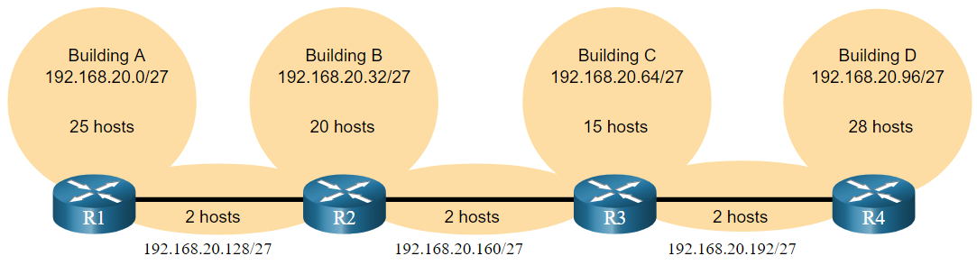
VLSM
IPv4 Address Conservation
Given the 192.168.20.0/24 network to support the following topology, 7 subnets are required (i.e, four LANs and three WAN links) and the largest number of host is in Building D with 28 hosts.
A /27 mask would provide 8 subnets of 30 host IP addresses and therefore support this topology.
For the last byte:
00000000 = 0
00100000 = 32
01000000 = 64
….
11000000 = 192
Notes:
11 – IPv4 Addressing
11.8 – VLSM
11.8.3 – IPv4 Address Conservation

Slide 57
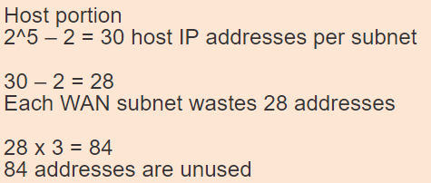
VLSM
IPv4 Address Conservation (Cont.)
However, the point-to-point WAN links only require two addresses and therefore waste 28 addresses each for a total of 84 unused addresses.
Applying a traditional subnetting scheme to this scenario is not very efficient and is wasteful.
VLSM was developed to avoid wasting addresses by enabling us to subnet a subnet.
Notes:
11 – IPv4 Addressing
11.8 – VLSM
11.8.3 – IPv4 Address Conservation

Slide 58
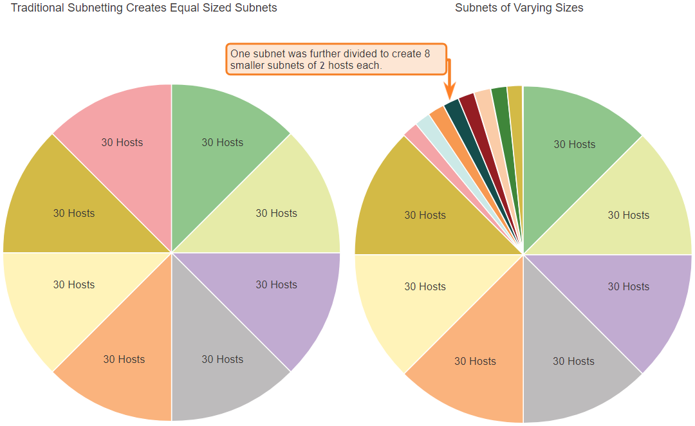
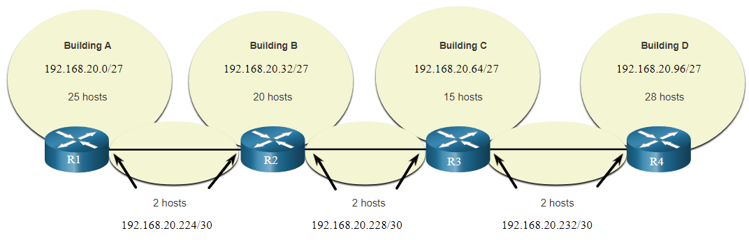
VLSM
VLSM
The left side displays the traditional subnetting scheme (i.e., the same subnet mask) while the right side illustrates how VLSM can be used to subnet a subnet and divided the last subnet into eight /30 subnets.
When using VLSM, always begin by satisfying the host requirements of the largest subnet and continue subnetting until the host requirements of the smallest subnet are satisfied.
The resulting topology with VLSM applied.
For the subnet connecting two routers,
/30 is used:
11100000 = 224
11100100 = 228
11101100 = 232
Notes:
11 – IPv4 Addressing
11.8 – VLSM
11.8.4 – VLSM

Slide 59
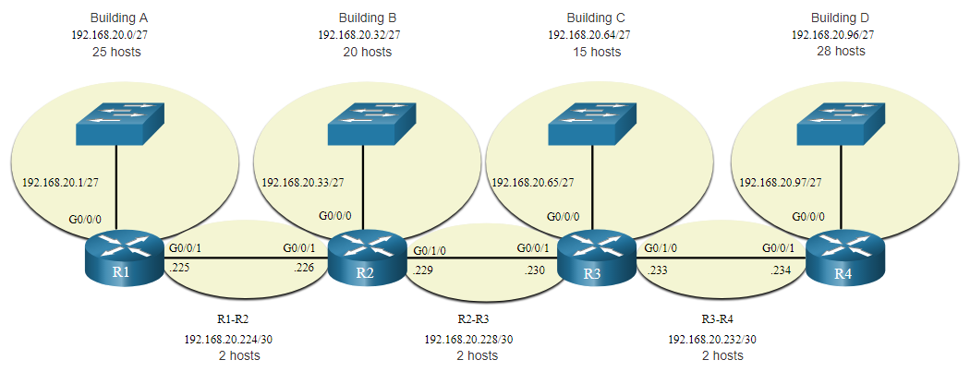
VLSM
VLSM Topology Address Assignment
Using VLSM subnets, the LAN and inter-router networks can be addressed without unnecessary waste as shown in the logical topology diagram.
Notes:
11 – IPv4 Addressing
11.8 – VLSM
11.8.5 – VLSM Topology Address Assignment
11.8.6 – Activity - VLSM Practice

Slide 60
Supernetting
The idea of subnetting is generalized: the division between prefix and suffix can occur on an arbitrary bit boundary
Besides allowing subnetting, networks can be aggregated to form a supernet
Summarize a contiguous group of /24 networks
Example: 200.158.16.0/20
  IP add = 11001000 10011110 00010000 00000000
  Mask = 11111111 11111111 11110000 00000000
  Contains 16 smaller size /24 networks:
  From 11001000 10011110 00010000 00000000
  i.e. 200.158.16.0/24
  Up to 10010110 10011110 00011111 00000000
  i.e. 200.158.31.0/24

Slide 61
Classless Inter-Domain Routing (CIDR)
CIDR deals with Routing Table Explosion Problem
  Networks represented by prefix and mask
  Without CIDR: Network with range of 16 contiguous /24 networks requires 16 entries in the routing table
  With CIDR: the same group of networks only requires 1 entry in the routing table

Slide 62
Hierarchical addressing: route aggregation
hierarchical addressing allows efficient advertisement of routing
information:
Organization 0
200.23.16.0/23
Organization 1
200.23.18.0/23
“Send me anything
with addresses
beginning
200.23.16.0/20”
Organization 2
200.23.20.0/23
.
Fly-By-Night-ISP
.
.
.
.
Internet
Organization 7
.
200.23.30.0/23
ISPs-R-Us
“Send me anything
with addresses
beginning
199.31.0.0/16”

Slide 63
Hierarchical addressing: more specific routes
ISPs-R-Us has a more specific route to Organization 1
Organization 0
200.23.16.0/23
“Send me anything
with addresses
beginning
200.23.16.0/20”
Organization 2
200.23.20.0/23
.
Fly-By-Night-ISP
.
.
.
.
Internet
Organization 7
.
200.23.30.0/23
ISPs-R-Us
“Send me anything
with addresses
beginning 199.31.0.0/16
or 200.23.18.0/23”
Organization 1
200.23.18.0/23

Slide 64
Longest Prefix Match
CIDR impacts routing & forwarding
Forwarding tables and routing protocols must carry IP address and mask
Multiple entries may match a given IP destination address
Example: Routing table may contain
  200.23.18.0/23 which corresponds to a given network
  200.23.16.0/20 which results from aggregation of a larger number of destinations into a supernet
  Packet must be routed using the more specific route, that is, the longest prefix match

Slide 65
Chapter 4: outline
4.1 Overview of Network layer
  data plane
  control plane
4.3 IP: Internet Protocol
  datagram format
  fragmentation
  IPv4 addressing
  DHCP and network address translation
  ICMP
  IPv6
4.4 Generalized Forward and SDN
  match
  action
  OpenFlow examples of match-plus-action in action

Slide 66
IP addresses: how to get one?
Q: How does a host get IP address?
hard-coded by system admin in a file
  Windows: control-panel->network->configuration->tcp/ip->properties
  UNIX: /etc/rc.config
DHCP: Dynamic Host Configuration Protocol: dynamically get address from as server
  “plug-and-play”

Slide 67
DHCP: Dynamic Host Configuration Protocol
goal: allow host to dynamically obtain its IP address from network server when it joins network
  can renew its lease on address in use
  allows reuse of addresses (only hold address while connected/“on”)
  support for mobile users who want to join network (more shortly)
DHCP overview:
  host broadcasts “DHCP discover” msg [optional]
  DHCP server responds with “DHCP offer” msg [optional]
  host requests IP address: “DHCP request” msg
  DHCP server sends address: “DHCP ack” msg

Slide 68


DHCP client-server scenario
DHCP
server
223.1.1.0/24
223.1.1.1
223.1.2.1
223.1.1.2
arriving DHCP
client needs
address in this
network
223.1.1.4
223.1.2.9
223.1.3.27
223.1.2.2
223.1.1.3
223.1.2.0/24
223.1.3.1
223.1.3.2
223.1.3.0/24

Slide 69
DHCP client-server scenario
DHCP server: 223.1.2.5
DHCP discover
arriving
client
src : 0.0.0.0, 68
dest.: 255.255.255.255,67
yiaddr: 0.0.0.0
transaction ID: 654
Broadcast: is there a DHCP server out there?
DHCP offer
src: 223.1.2.5, 67
dest: 255.255.255.255, 68
yiaddrr: 223.1.2.4
transaction ID: 654
lifetime: 3600 secs
Broadcast: I’m a DHCP server! Here’s an IP address you can use
DHCP request
src: 0.0.0.0, 68
dest:: 255.255.255.255, 67
yiaddrr: 223.1.2.4
transaction ID: 655
lifetime: 3600 secs
Broadcast: OK. I’ll take that IP address!
DHCP ACK
src: 223.1.2.5, 67
dest: 255.255.255.255, 68
yiaddrr: 223.1.2.4
transaction ID: 655
lifetime: 3600 secs
Broadcast: OK. You’ve got that IP address!

Slide 70
DHCP: more than IP addresses
DHCP can return more than just allocated IP address on subnet:
  address of first-hop router for client
  name and IP address of DNS sever
  network mask (indicating network versus host portion of address)

Slide 71


DHCP: example
DHCP
DHCP
UDP
IP
Eth
Phy
connecting laptop needs its IP address, addr of first-hop router, addr of DNS server: use DHCP
DHCP
DHCP
DHCP
DHCP
DHCP request encapsulated in UDP, encapsulated in IP, encapsulated in 802.1 Ethernet
DHCP
DHCP
UDP
IP
Eth
Phy
168.1.1.1
DHCP
DHCP
DHCP
Ethernet frame broadcast (dest: FFFFFFFFFFFF) on LAN, received at router running DHCP server
DHCP
router with DHCP
server built into
router
Ethernet demuxed to IP demuxed, UDP demuxed to DHCP

Slide 72
DHCP: example
DHCP
UDP
IP
Eth
Phy
DHCP server formulates DHCP ACK containing client’s IP address, IP address of first-hop router for client, name & IP address of DNS server
DHCP
DHCP
DHCP
DHCP
encapsulation of DHCP ACK, frame forwarded to client, demuxing up to DHCP at client
DHCP
DHCP
UDP
IP
Eth
Phy
DHCP
DHCP
DHCP
router with DHCP
server built into
router
client now knows its IP address, name and IP address of DNS server, IP address of its first-hop router
DHCP

Slide 73
DHCP: Wireshark output (home LAN)
reply
Message type: Boot Reply (2)
Hardware type: Ethernet
Hardware address length: 6
Hops: 0
Transaction ID: 0x6b3a11b7
Seconds elapsed: 0
Bootp flags: 0x0000 (Unicast)
Client IP address: 192.168.1.101 (192.168.1.101)
Your (client) IP address: 0.0.0.0 (0.0.0.0)
Next server IP address: 192.168.1.1 (192.168.1.1)
Relay agent IP address: 0.0.0.0 (0.0.0.0)
Client MAC address: Wistron_23:68:8a (00:16:d3:23:68:8a)
Server host name not given
Boot file name not given
Magic cookie: (OK)
Option: (t=53,l=1) DHCP Message Type = DHCP ACK
Option: (t=54,l=4) Server Identifier = 192.168.1.1
Option: (t=1,l=4) Subnet Mask = 255.255.255.0
Option: (t=3,l=4) Router = 192.168.1.1
Option: (6) Domain Name Server
Length: 12; Value: 445747E2445749F244574092;
IP Address: 68.87.71.226;
IP Address: 68.87.73.242;
IP Address: 68.87.64.146
Option: (t=15,l=20) Domain Name = "hsd1.ma.comcast.net."
Message type: Boot Request (1)
Hardware type: Ethernet
Hardware address length: 6
Hops: 0
Transaction ID: 0x6b3a11b7
Seconds elapsed: 0
Bootp flags: 0x0000 (Unicast)
Client IP address: 0.0.0.0 (0.0.0.0)
Your (client) IP address: 0.0.0.0 (0.0.0.0)
Next server IP address: 0.0.0.0 (0.0.0.0)
Relay agent IP address: 0.0.0.0 (0.0.0.0)
Client MAC address: Wistron_23:68:8a (00:16:d3:23:68:8a)
Server host name not given
Boot file name not given
Magic cookie: (OK)
Option: (t=53,l=1) DHCP Message Type = DHCP Request
Option: (61) Client identifier
Length: 7; Value: 010016D323688A;
Hardware type: Ethernet
Client MAC address: Wistron_23:68:8a (00:16:d3:23:68:8a)
Option: (t=50,l=4) Requested IP Address = 192.168.1.101
Option: (t=12,l=5) Host Name = "nomad"
Option: (55) Parameter Request List
Length: 11; Value: 010F03062C2E2F1F21F92B
1 = Subnet Mask; 15 = Domain Name
3 = Router; 6 = Domain Name Server
44 = NetBIOS over TCP/IP Name Server
……
request

Slide 74
NAT: network address translation
rest of
Internet
local network
(e.g., home network)
10.0.0/24
10.0.0.1
10.0.0.4
10.0.0.2
138.76.29.7
10.0.0.3
all datagrams leaving local
network have same single source NAT IP address: 138.76.29.7,different source port numbers
datagrams with source or
destination in this network
have 10.0.0/24 address for
source, destination (as usual)

Slide 75
NAT: network address translation
motivation: local network uses just one IP address as far as outside world is concerned:
  range of addresses not needed from ISP: just one IP address for all devices
  can change addresses of devices in local network without notifying outside world
  can change ISP without changing addresses of devices in local network
  devices inside local net not explicitly addressable, visible by outside world (a security plus)

Slide 76
NAT: network address translation
implementation: NAT router must:
  outgoing datagrams: replace (source IP address, port #) of every outgoing datagram to (NAT IP address, new port #)
    . . . remote clients/servers will respond using (NAT IP address, new port #) as destination addr
  remember (in NAT translation table) every (source IP address, port #) to (NAT IP address, new port #) translation pair
  incoming datagrams: replace (NAT IP address, new port #) in dest fields of every incoming datagram with corresponding (source IP address, port #) stored in NAT table

Slide 77
NAT: network address translation
NAT translation table
WAN side addr LAN side addr
2: NAT router
changes datagram
source addr from
10.0.0.1, 3345 to
138.76.29.7, 5001,
updates table
1: host 10.0.0.1
sends datagram to
128.119.40.186, 80
138.76.29.7, 5001 10.0.0.1, 3345
…… ……
S: 10.0.0.1, 3345
D: 128.119.40.186, 80
10.0.0.1
1
2
S: 138.76.29.7, 5001
D: 128.119.40.186, 80
10.0.0.4
10.0.0.2
138.76.29.7
S: 128.119.40.186, 80
D: 10.0.0.1, 3345
4
S: 128.119.40.186, 80
D: 138.76.29.7, 5001
3
10.0.0.3
4: NAT router
changes datagram
dest addr from
138.76.29.7, 5001 to 10.0.0.1, 3345
3: reply arrives
dest. address:
138.76.29.7, 5001
* Check out the online interactive exercises for more examples: http://gaia.cs.umass.edu/kurose_ross/interactive/

Slide 78
NAT: network address translation
16-bit port-number field:
  60,000 simultaneous connections with a single LAN-side address!
NAT is controversial:
  routers should only process up to layer 3
  address shortage should be solved by IPv6
  violates end-to-end argument
    NAT possibility must be taken into account by app designers, e.g., P2P applications

Slide 79
Chapter 4: outline
4.1 Overview of Network layer
  data plane
  control plane
4.3 IP: Internet Protocol
  datagram format
  fragmentation
  IPv4 addressing
  DHCP and network address translation
  ICMP
  IPv6
4.4 Generalized Forward and SDN
  match
  action
  OpenFlow examples of match-plus-action in action

Slide 80
Internet Control Message Protocol (ICMP)
RFC 792; Encapsulated in IP packet (protocol type = 1)
Handles error and control messages
If router cannot deliver or forward a packet, it sends an ICMP “host unreachable” message to the source
If router receives packet that should have been sent to another router, it sends an ICMP “redirect” message to the sender; Sender modifies its routing table
ICMP “router discovery” messages allow host to learn about routers in its network and to initialize and update its routing tables
ICMP echo request and reply facilitate diagnostic and used in “ping”

Slide 81
ICMP Basic Error Message Format
0 8 16 31
Type Code Checksum
Unused
IP header and 64 bits of original datagram
Type of message: e.g.: Type=3, Destination Unreachable
Code: purpose of message, e.g.: for Type=3
  0 Network Unreachable; 3 Port Unreachable
  1 Host Unreachable 4 Fragmentation needed
  2 Protocol Unreachable 5 Source route failed
IP header & 64 bits of original datagram
  To match ICMP message with original data in IP packet

Slide 82
Echo Request & Echo Reply Message Format
0 8 16 31
Type Code Checksum
Identifier Sequence number
Data
Echo request: type=8; Echo reply: type=0
  Destination replies with echo reply by copying data in request onto reply message
Sequence number to match reply to request
ID to distinguish between different sessions using echo services
Used in PING

Slide 83
Chapter 4: outline
4.1 Overview of Network layer
  data plane
  control plane
4.3 IP: Internet Protocol
  datagram format
  fragmentation
  IPv4 addressing
  DHCP and network address translation
  ICMP
  IPv6
4.4 Generalized Forward and SDN
  match
  action
  OpenFlow examples of match-plus-action in action

Slide 84
IPv6: motivation
initial motivation: 32-bit address space is not enough
additional motivation:
  header format helps speed processing/forwarding
  header changes to facilitate QoS
IPv6 datagram format:
  fixed-length 40 byte header
  no fragmentation allowed

Slide 85
IPv6 datagram format
priority: identify priority among datagrams in flow
flow Label: identify datagrams in same “flow.”
(concept of“flow” not well defined).
next header: identify upper layer protocol for data
ver
pri
flow label
payload len
next hdr
hop limit
source address
(128 bits)
destination address
(128 bits)
data
32 bits

Slide 86
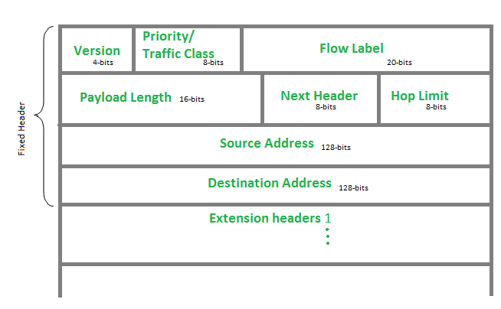
Extension Headers
Extension header is introduced in IPv6 to support
more functionalities
Source: https://www.geeksforgeeks.org/internet-protocol-version-6-ipv6-header/

Slide 87
Extension Headers (cont’d)
Daisy chains of extension headers
Basic header
Next header =
TCP segment
TCP
Basic header
Routing header
Fragment header
Authentication header
Next header =
Next header =
Next header =
Next header =
TCP segment
routing
fragment
authentication
TCP
Extension headers processed in order of appearance

Slide 88
Other changes from IPv4
checksum: removed entirely to reduce processing time at each hop
options: allowed, but outside of header, indicated by “Next Header” field
ICMPv6: new version of ICMP
  additional message types, e.g. “Packet Too Big”
  multicast group management functions

Slide 89
12.2 IPv6 Address Representation
Notes:
12-IPv6 Addressing
12.2 IPv4 Address Representation

Slide 90
IPv6 Address Representation
IPv6 Addressing Formats
IPv6 addresses are 128 bits in length and written in hexadecimal.
IPv6 addresses are not case-sensitive and can be written in either lowercase or uppercase.
The preferred format for writing an IPv6 address is x:x:x:x:x:x:x:x, with each “x” consisting of four hexadecimal values.
In IPv6, a hextet is the unofficial term used to refer to a segment of 16 bits, or four hexadecimal values.
Examples of IPv6 addresses in the preferred format:
        2001:0db8:0000:1111:0000:0000:0000:0200
        2001:0db8:0000:00a3:abcd:0000:0000:1234
Notes:
12 – IPv6 Addressing
12.2 – IPv6 Address Representation
12.2.1 – IPv6 Addressing Formats

Slide 91
IPv6 Address Representation
Rule 1 – Omit Leading Zero
The first rule to help reduce the notation of IPv6 addresses is to omit any leading 0s (zeros).
  Examples:
01ab can be represented as 1ab
09f0 can be represented as 9f0
0a00 can be represented as a00
00ab can be represented as ab
Note: This rule only applies to leading 0s, NOT to trailing 0s, otherwise the address would be ambiguous.
Type | Format
Preferred | 2001 : 0db8 : 0000 : 1111 : 0000 : 0000 : 0000 : 0200
No leading zeros | 2001 : db8 : 0 : 1111 : 0 : 0 : 0 : 200
Notes:
12 – IPv6 Addressing
12.2 – IPv6 Address Representation
12.2.2 – Omit Leading Zero

Slide 92
IPv6 Address Representation
Rule 2 – Double Colon
A double colon (::) can replace any single, contiguous string of one or more 16-bit hextets consisting of all zeros.
Example:
2001:db8:cafe:1:0:0:0:1 (leading 0s omitted) could be represented as 2001:db8:cafe:1::1
Note: The double colon (::) can only be used once within an address, otherwise there would be more than one possible resulting address.
Type | Format
Preferred | 2001 : 0db8 : 0000 : 1111 : 0000 : 0000 : 0000 : 0200
Compressed | 2001:db8:0:1111::200
Notes:
12 – IPv6 Addressing
12.2 – IPv6 Address Representation
12.2.2 – Rule 2 – Double Colon
12.2.4 – Activity – IPv6 Address Representation

Slide 93
12.3 IPv6 Address Types
Notes:
12-IPv6 Addressing
12.2 IPv4 Address Types

Slide 94
IPv6 Address Types
Unicast, Multicast, Anycast
There are three broad categories of IPv6 addresses:
Unicast – Unicast uniquely identifies an interface on an IPv6-enabled device.
Multicast – Multicast is used to send a single IPv6 packet to multiple destinations.
Anycast – This is any IPv6 unicast address that can be assigned to multiple devices. A packet sent to an anycast address is routed to the nearest device having that address.
Note: Unlike IPv4, IPv6 does not have a broadcast address. However, there is an IPv6 all-nodes multicast address that essentially gives the same result.
Notes:
12 – IPv6 Addressing
12.3 – IPv6 Address Types
12.3.1 – Unicast, Multicast, Anycast

Slide 95
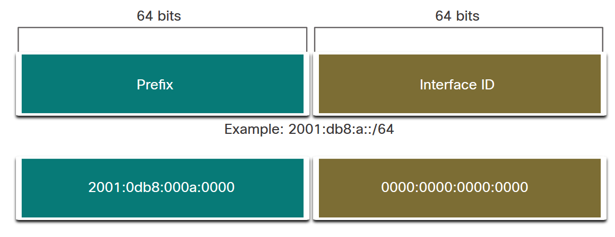
IPv6 Address Types
IPv6 Prefix Length
Prefix length is represented in slash notation and is used to indicate the network portion of an IPv6 address.
The IPv6 prefix length can range from 0 to 128. The recommended IPv6 prefix length for LANs and most other types of networks is /64.
Note: It is strongly recommended to use a 64-bit Interface ID for most networks. This is because stateless address autoconfiguration (SLAAC) uses 64 bits for the Interface ID. It also makes subnetting easier to create and manage.
Notes:
12 – IPv6 Addressing
12.3 – IPv6 Address Types
12.3.2 – IPv6 Prefix Length

Slide 96
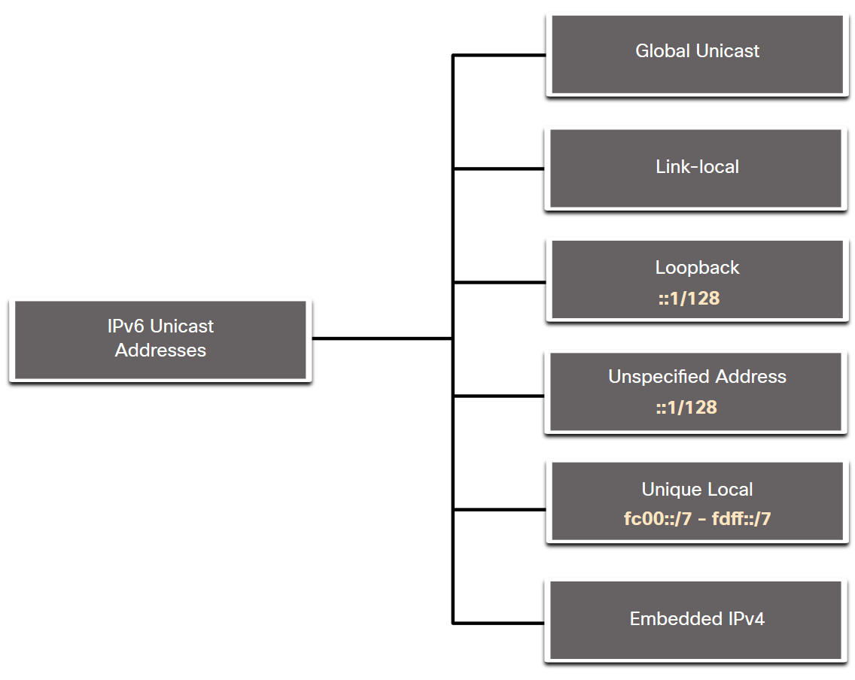
IPv6 Address Types
Types of IPv6 Unicast Addresses
Unlike IPv4 devices that have only a single address, IPv6 devices typically have two unicast addresses:
Global Unicast Address (GUA) – This is similar to a public IPv4 address. These are globally unique, internet-routable addresses.
Link-local Address (LLA) - Required for every IPv6-enabled device and used to communicate with other devices on the same local link. LLAs are not routable and are confined to a single link.
Notes:
12 – IPv6 Addressing
12.3 – IPv6 Address Types
12.3.3 – Types of IPv6 unicast Addresses

Slide 97
IPv6 Address Types
A Note About the Unique Local Address
The IPv6 unique local addresses (range fc00::/7 to fdff::/7) have some similarity to RFC 1918 private addresses for IPv4, but there are significant differences:
Unique local addresses are used for local addressing within a site or between a limited number of sites.
Unique local addresses can be used for devices that will never need to access another network.
Unique local addresses are not globally routed or translated to a global IPv6 address.
Note: Many sites use the private nature of RFC 1918 addresses to attempt to secure or hide their network from potential security risks. This was never the intended use of ULAs.
Notes:
12 – IPv6 Addressing
12.3 – IPv6 Address Types
12.3.4 – A Note About the Unique Local Address

Slide 98
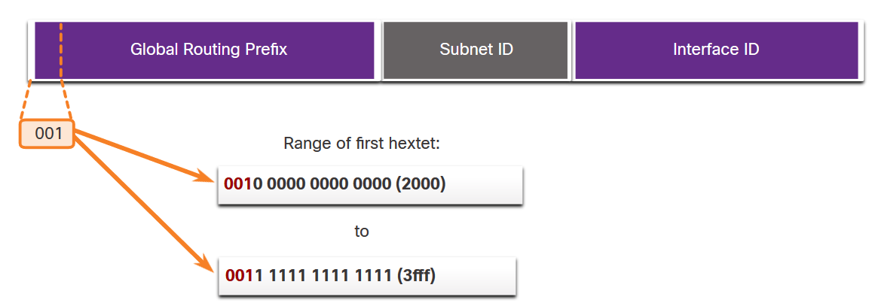
IPv6 Address Types
IPv6 GUA
IPv6 global unicast addresses (GUAs) are globally unique and routable on the IPv6 internet.
Currently, only GUAs with the first three bits of 001 or 2000::/3 are being assigned.
Currently available GUAs begins with a hexadecimal 2 or a 3 (This is only 1/8th of the total available IPv6 address space).
Notes:
12 – IPv6 Addressing
12.3 – IPv6 Address Types
12.3.5 – IPv6 GUA

Slide 99
IPv6 Address Types
IPv6 GUA Structure
Global Routing Prefix:
  The global routing prefix is the prefix, or network, portion of the address that is assigned by the provider, such as an ISP, to a customer or site. The global routing prefix will vary depending on ISP policies.
Subnet ID:
  The Subnet ID field is the area between the Global Routing Prefix and the Interface ID. The Subnet ID is used by an organization to identify subnets within its site.
Interface ID:
  The IPv6 interface ID is equivalent to the host portion of an IPv4 address. It is strongly recommended that in most cases /64 subnets should be used, which creates a 64-bit interface ID.
Note: IPv6 allows the all-0s and all-1s host addresses can be assigned to a device. The all-0s address is reserved as a Subnet-Router anycast address, and should be assigned only to routers.
Notes:
12 – IPv6 Addressing
12.3 – IPv6 Address Types
12.3.5 – IPv6 GUA Structure

Slide 100
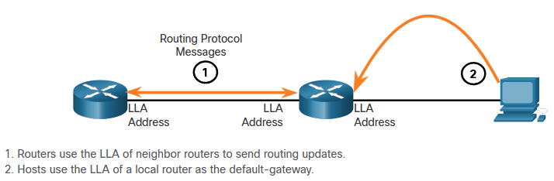
IPv6 Address Types
IPv6 LLA
An IPv6 link-local address (LLA) enables a device to communicate with other IPv6-enabled devices on the same link and only on that link (subnet).
Packets with a source or destination LLA cannot be routed.
Every IPv6-enabled network interface must have an LLA.
If an LLA is not configured manually on an interface, the device will automatically create one.
IPv6 LLAs are in the fe80::/10 range.
Notes:
12 – IPv6 Addressing
12.3 – IPv6 Address Types
12.3.6 – IPv6 LLA
12.3.7 – Check Your Understanding – IPv6 Address Types

Slide 101
12.5 Dynamic Addressing for IPv6 GUAs
Notes:
12-IPv6 Addressing
12.5 IPv4 Dynamic Addressing for IPv6 GUAs

Slide 102
Dynamic Addressing for IPv6 GUAs
RS and RA Messages
Devices obtain GUA addresses dynamically through Internet Control Message Protocol version 6 (ICMPv6) messages.
  Router Solicitation (RS) messages are sent by host devices to discover IPv6 routers
  Router Advertisement (RA) messages are sent by routers to inform hosts on how to obtain an IPv6 GUA and provide useful network information such as:
    Network prefix and prefix length
    Default gateway address
    DNS addresses and domain name
  The RA can provide three methods for configuring an IPv6 GUA :
    SLAAC (StateLess Address Auto Configuration)
    SLAAC with stateless DHCPv6 server
    Stateful DHCPv6 (no SLAAC)
Notes:
12 – IPv6 Addressing
12.5 – Dynamic Addressing for IPv6 GUAs
12.5.1 – RS and RA Messages

Slide 103
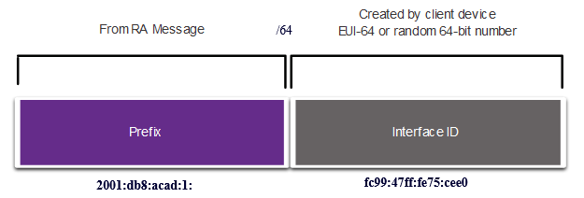
Dynamic Addressing for IPv6 GUAs
Method 1: SLAAC
SLAAC allows a device to configure a GUA without the services of DHCPv6.
Devices obtain the necessary information to configure a GUA from the ICMPv6 RA messages of the local router.
The prefix is provided by the RA and the device uses either the EUI-64 or random generation method to create an interface ID.
Notes:
12 – IPv6 Addressing
12.5 – Dynamic Addressing for IPv6 GUAs
12.5.2 – Method 1: SLAAC

Slide 104
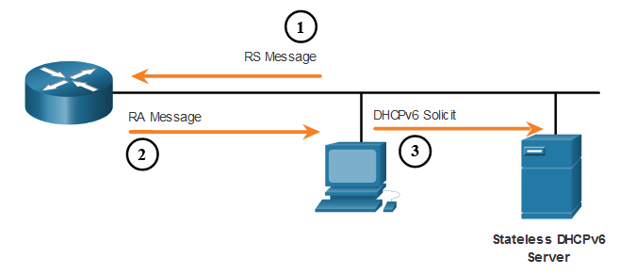
Dynamic Addressing for IPv6 GUAs
Method 2: SLAAC and Stateless DHCP
An RA can instruct a device to use both SLAAC and stateless DHCPv6.
The RA message suggests devices use the following:
    SLAAC to create its own IPv6 GUA
    The router LLA, which is the RA source IPv6 address, as the default gateway address
    A stateless DHCPv6 server to obtain other information such as a DNS server address and a domain name
Notes:
12 – IPv6 Addressing
12.5 – Dynamic Addressing for IPv6 GUAs
12.5.3 – Method 2: SLAAC and Stateless DHCP

Slide 105
Dynamic Addressing for IPv6 GUAs
Method 3: Stateful DHCPv6
An RA can instruct a device to use stateful DHCPv6 only.
Stateful DHCPv6 is similar to DHCP for IPv4. A device can automatically receive a GUA, prefix length, and the addresses of DNS servers from a stateful DHCPv6 server.
The RA message suggests devices use the following:
    The router LLA, which is the RA source IPv6 address, for the default gateway address.
    A stateful DHCPv6 server to obtain a GUA, DNS server address, domain name and other necessary information.
Notes:
12 – IPv6 Addressing
12.5 – Dynamic Addressing for IPv6 GUAs
12.5.4 – Method 3: Stateful DHCPv6

Slide 106
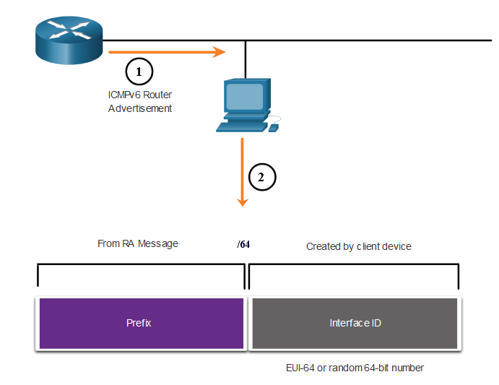
Dynamic Addressing for IPv6 GUAs
EUI-64 Process vs. Randomly Generated
When the RA message is either SLAAC or SLAAC with stateless DHCPv6, the client must generate its own interface ID.
The interface ID can be created using the EUI-64 process or a randomly generated 64-bit number.
Notes:
12 – IPv6 Addressing
12.5 – Dynamic Addressing for IPv6 GUAs
12.5.5 – EUI-64 Process vs. Randomly Generated

Slide 107
Dynamic Addressing for IPv6 GUAs
EUI-64 Process
The IEEE defined the Extended Unique Identifier (EUI) or modified EUI-64 process which performs the following:
A 16 bit value of fffe (in hexadecimal) is inserted into the middle of the 48-bit Ethernet MAC address of the client.
The 7th bit of the client MAC address is reversed from binary 0 to 1.
Example:
48-bit MAC | fc:99:47:75:ce:e0
EUI-64 Interface ID | fe:99:47:ff:fe:75:ce:e0
Notes:
12 – IPv6 Addressing
12.5 – Dynamic Addressing for IPv6 GUAs
12.5.6 – EUI-64 Process

Slide 108
Dynamic Addressing for IPv6 GUAs
Randomly Generated Interface IDs
Depending upon the operating system, a device may use a randomly generated interface ID instead of using the MAC address and the EUI-64 process.
Beginning with Windows Vista, Windows uses a randomly generated interface ID instead of one created with EUI-64.
C:\> ipconfig
Windows IP Configuration
Ethernet adapter Local Area Connection:
Connection-specific DNS Suffix . :
IPv6 Address. . . . . . . . . . . : 2001:db8:acad:1:50a5:8a35:a5bb:66e1
Link-local IPv6 Address . . . . . : fe80::50a5:8a35:a5bb:66e1
Default Gateway . . . . . . . . . : fe80::1
C:\>
Note: To ensure the uniqueness of any IPv6 unicast address, the client may use a process known as Duplicate Address Detection (DAD). This is similar to an ARP request for its own address. If there is no reply, then the address is unique.
Notes:
12 – IPv6 Addressing
12.5 – Dynamic Addressing for IPv6 GUAs
12.5.7 – Randomly Generated Interface IDs
12.5.8 – Check Your Understanding – Dynamic Address for IPv6 GUAs

Slide 109
12.6 Dynamic Addressing for IPv6 LLAs
Notes:
12-IPv6 Addressing
12.6 IPv4 Dynamic Addressing for IPv6 LLAs

Slide 110
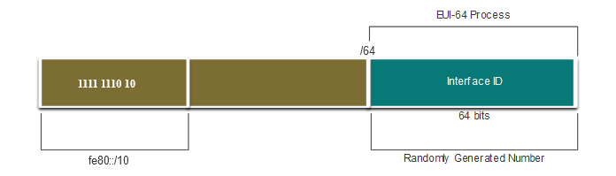
Dynamic Addressing for IPv6 LLAs
Dynamic LLAs
All IPv6 interfaces must have an IPv6 LLA.
Like IPv6 GUAs, LLAs can be configured dynamically.
The figure shows the LLA is dynamically created using the fe80::/10 prefix and the interface ID using the EUI-64 process, or a randomly generated 64-bit number.
Notes:
12 – IPv6 Addressing
12.6 – Dynamic Addressing for IPv6 LLAs
12.6.1 – Dynamic LLAs

Slide 111
Dynamic Addressing for IPv6 LLAs
Dynamic LLAs on Windows
Operating systems, such as Windows, will typically use the same method for both a SLAAC-created GUA and a dynamically assigned LLA.
EUI-64 Generated Interface ID:
C:\> ipconfig
Windows IP Configuration
Ethernet adapter Local Area Connection:
Connection-specific DNS Suffix . :
IPv6 Address. . . . . . . . . . . : 2001:db8:acad:1:fc99:47ff:fe75:cee0
Link-local IPv6 Address . . . . . : fe80::fc99:47ff:fe75:cee0
Default Gateway . . . . . . . . . : fe80::1
C:\>
Random 64-bit Generated Interface ID:
C:\> ipconfig
Windows IP Configuration
Ethernet adapter Local Area Connection:
Connection-specific DNS Suffix . :
IPv6 Address. . . . . . . . . . . : 2001:db8:acad:1:50a5:8a35:a5bb:66e1
Link-local IPv6 Address . . . . . : fe80::50a5:8a35:a5bb:66e1
Default Gateway . . . . . . . . . : fe80::1
C:\>
Notes:
12 – IPv6 Addressing
12.6 – Dynamic Addressing for IPv6 LLAs
12.6.2 – Dynamic LLAs on Windows

Slide 112
Dynamic Addressing for IPv6 LLAs
Dynamic LLAs on Cisco Routers
Cisco routers automatically create an IPv6 LLA whenever a GUA is assigned to the interface. By default, Cisco IOS routers use EUI-64 to generate the interface ID for all LLAs on IPv6 interfaces.
Here is an example of a LLA dynamically configured on the G0/0/0 interface of R1:
R1# show interface gigabitEthernet 0/0/0
GigabitEthernet0/0/0 is up, line protocol is up
Hardware is ISR4221-2x1GE, address is 7079.b392.3640 (bia 7079.b392.3640)
(Output omitted)
R1# show ipv6 interface brief
GigabitEthernet0/0/0 [up/up]
FE80::7279:B3FF:FE92:3640
2001:DB8:ACAD:1::1
Notes:
12 – IPv6 Addressing
12.6 – Dynamic Addressing for IPv6 LLAs
12.6.3 – Dynamic LLAs on Cisco Routers

Slide 113
12.8 Subnet an IPv6 Network
Notes:
12-IPv6 Addressing
12.8 Subnet an IPv6 Network

Slide 114
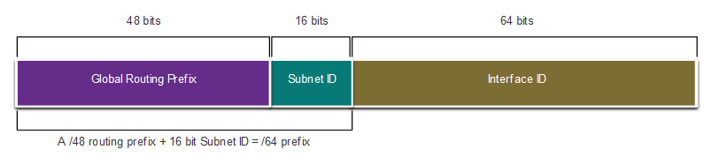
Subnet an IPv6 Network
Subnet Using the Subnet ID
IPv6 was designed with subnetting in mind.
A separate subnet ID field in the IPv6 GUA is used to create subnets.
The subnet ID field is the area between the Global Routing Prefix and the interface ID.
Notes:
12 – IPv6 Addressing
12.8 – Subnet an IPv6 Network
12.8.1 – Subnet Using the Subnet ID

Slide 115
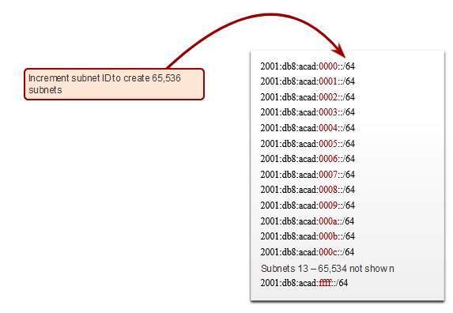
Subnet an IPv6 Network
IPv6 Subnetting Example
Given the 2001:db8:acad::/48 global routing prefix with a 16 bit subnet ID.
Allows 65,536 /64 subnets
The global routing prefix is the same for all subnets.
Only the subnet ID hextet is incremented in hexadecimal for each subnet.
Notes:
12 – IPv6 Addressing
12.8 – Subnet an IPv6 Network
12.8.2 – IPv6 Subnetting Example

Slide 116
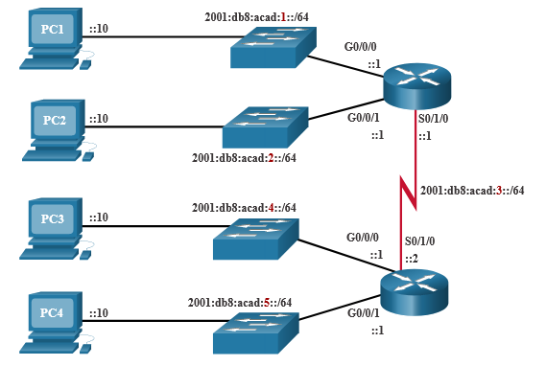
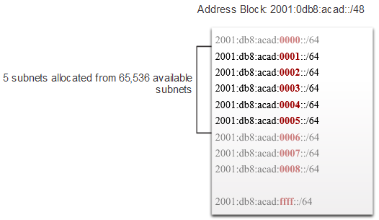
Subnet an IPv6 Network
IPv6 Subnet Allocation
The example topology requires five subnets, one for each LAN as well as for the serial link between R1 and R2.
The five IPv6 subnets were allocated, with the subnet ID field 0001 through 0005. Each /64 subnet will provide more addresses than will ever be needed.
Notes:
12 – IPv6 Addressing
12.8 – Subnet an IPv6 Network
12.8.3 – IPv6 Subnet Allocation

Slide 117
IPv4 and IPv6 Coexistence
Both IPv4 and IPv6 will coexist in the near future and the transition will take several years.
The IETF has created various protocols and tools to help network administrators migrate their networks to IPv6. These migration techniques can be divided into three categories:
  Dual stack -The devices run both IPv4 and IPv6 protocol stacks simultaneously.
  Tunneling – A method of transporting an IPv6 packet over an IPv4 network. The IPv6 packet is encapsulated inside an IPv4 packet.
  Translation - Network Address Translation 64 (NAT64) allows IPv6-enabled devices to communicate with IPv4-enabled devices using a translation technique similar to NAT for IPv4.
Note: Tunneling and translation are for transitioning to native IPv6 and should only be used where needed. The goal should be native IPv6 communications from source to destination.
Notes:
12 – IPv6 Addressing
12.1 – IPv4 Issues
12.1.2 – IPv4 and IPv6 Coexistence
12.1.3 – Check Your Understanding – IPv4 Issues

Slide 118
Tunneling
IPv6 datagram carried as payload in IPv4 datagram among IPv4 routers
IPv4 header fields
IPv6 header fields
IPv4 payload
IPv4 source, dest addr
IPv6 source dest addr
UDP/TCP payload
IPv6 datagram
IPv4 datagram

Slide 119
Tunneling
A
B
IPv4 tunnel
connecting IPv6 routers
E
F
logical view:
IPv6
IPv6
IPv6
IPv6
A
B
C
D
E
F
physical view:
IPv6
IPv6
IPv4
IPv4
IPv6
IPv6

Slide 120
Tunneling
A
B
IPv4 tunnel
connecting IPv6 routers
E
F
logical view:
IPv6
IPv6
IPv6
IPv6
A
B
C
D
E
F
physical view:
IPv6
IPv6
IPv4
IPv4
IPv6
IPv6
flow: X
src: A
dest: F
data
src:B
dest: E
src:B
dest: E
flow: X
src: A
dest: F
data
Flow: X
Src: A
Dest: F
data
Flow: X
Src: A
Dest: F
data
A-to-B:
IPv6
B-to-C:
IPv6 inside
IPv4
B-to-C:
IPv6 inside
IPv4
E-to-F:
IPv6

Slide 121
Chapter 4: outline
4.1 Overview of Network layer
  data plane
  control plane
4.3 IP: Internet Protocol
  datagram format
  fragmentation
  IPv4 addressing
  DHCP and network address translation
  ICMP
  IPv6
4.4 Generalized Forward and SDN
  match
  action
  OpenFlow examples of match-plus-action in action

Slide 122
Generalized Forwarding and SDN
Each router contains a flow table that is computed and distributed by a logically centralized routing controller
logically-centralized routing controller
control plane
data plane
local flow table
headers counters actions
1
0100 1101
3
2
values in arriving
packet’s header

Slide 123
OpenFlow data plane abstraction
flow: defined by header fields
generalized forwarding: simple packet-handling rules
  Pattern: match values in packet header fields
  Actions: for matched packet: drop, forward, modify, matched packet or send matched packet to controller
  Priority: disambiguate overlapping patterns
  Counters: #bytes and #packets
Flow table in a router (computed and distributed by controller) define router’s match+action rules

Slide 124
OpenFlow data plane abstraction
flow: defined by header fields
generalized forwarding: simple packet-handling rules
  Pattern: match values in packet header fields
  Actions: for matched packet: drop, forward, modify, matched packet or send matched packet to controller
  Priority: disambiguate overlapping patterns
  Counters: #bytes and #packets
* : wildcard
src=1.2.*.*, dest=3.4.5.* → drop
src = *.*.*.*, dest=3.4.*.* → forward(2)
3. src=10.1.2.3, dest=*.*.*.* → send to controller

Slide 125
OpenFlow: Flow Table Entries
Rule
Action
Stats
Packet + byte counters
Forward packet to port(s)
Encapsulate and forward to controller
Drop packet
Send to normal processing pipeline
Modify Fields
Switch
Port
VLAN
ID
MAC
src
MAC
dst
Eth
type
IP
Src
IP
Dst
IP
Prot
TCP
sport
TCP
dport
Link layer
Network layer
Transport layer
Notes:
Now I’ll describe the API that tries to meet these goals.
125

Slide 126
Examples
Destination-based forwarding:
Switch
Port
MAC
src
MAC
dst
Eth
type
VLAN
ID
IP
Src
IP
Dst
IP
Prot
TCP
sport
TCP
dport
Action
*
*
*
*
*
*
51.6.0.8
*
*
*
port6
IP datagrams destined to IP address 51.6.0.8 should be forwarded to router output port 6
Firewall:
Switch
Port
MAC
src
MAC
dst
Eth
type
VLAN
ID
IP
Src
IP
Dst
IP
Prot
TCP
sport
TCP
dport
Forward
*
*
*
*
*
*
*
*
*
22
drop
do not forward (block) all datagrams destined to TCP port 22
Switch
Port
MAC
src
MAC
dst
Eth
type
VLAN
ID
IP
Src
IP
Dst
IP
Prot
TCP
sport
TCP
dport
Forward
*
*
*
*
*
128.119.1.1
*
*
*
*
drop
do not forward (block) all datagrams sent by host 128.119.1.1

Slide 127
OpenFlow abstraction
match+action: unifies different kinds of devices
Router
  match: longest destination IP prefix
  action: forward out a link
Switch
  match: destination MAC address
  action: forward or flood
Firewall
  match: IP addresses and TCP/UDP port numbers
  action: permit or deny
NAT
  match: IP address and port
  action: rewrite address and port

Slide 128


OpenFlow example
Example: datagrams from hosts h5 and h6 should be sent to h3 or h4, via s1 and from there to s2
match
action
IP Src = 10.3.*.*
IP Dst = 10.2.*.*
forward(3)
Host h6
10.3.0.6
1
s3
controller
2
3
4
Host h5
10.3.0.5
1
s1
s2
1
2
Host h4
10.2.0.4
4
2
4
Host h1
10.1.0.1
3
3
Host h2
10.1.0.2
match
action
match
action
Host h3
10.2.0.3
ingress port = 2
IP Dst = 10.2.0.3
ingress port = 2
IP Dst = 10.2.0.4
forward(3)
ingress port = 1
IP Src = 10.3.*.*
IP Dst = 10.2.*.*
forward(4)
forward(4)

Slide 129
Chapter 4: done!
4.1 Overview of Network layer: data plane and control plane
4.3 IP: Internet Protocol
  datagram format
  fragmentation
  IPv4 addressing
  DHCP and NAT
  ICMP
  IPv6
4.4 Generalized Forward and SDN
  match plus action
  OpenFlow example
Question: how do forwarding tables (destination-based forwarding) or flow tables (generalized forwarding) computed?
Answer: by the control plane (EE3315)

